Slide 1

CIS215 Foundations of Data Analytics and Programming Instructor: Chris Santo Module #2 Practice Lab #1 Hello World Assignment Walkthrough

Slide 2
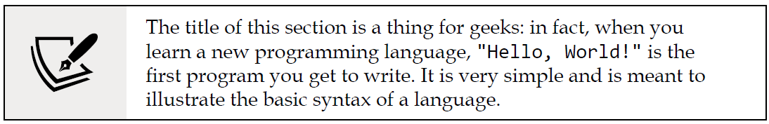
M2: Practice Lab #1 (Hello World) Assignment in KNIME
As you put together your first workflow, you will learn how to interact with KNIME's user interface to connect, configure, and execute nodes: this is the bread and butter of any KNIME user, which you are about to become.
Let's imagine we have a simple and repetitive data operation to perform regularly: every day we receive a text file in Comma-Separated Value (CSV) format, which reports the cumulative sales generated by country in the year to date. The original file has some unnecessary columns, and the order of rows is random. We need to apply some basic transformation steps so that we end up with a simple table showing just two columns: one is the name of the country, and the other is the amount of generated sales. We also want the rows to be sorted by decreasing sales. Lastly, we need to convert the file into Excel as it is a format that's easier to read for our colleagues. We can build a KNIME workflow that does exactly that once, in a way that we don't need to repeat the tedious task manually every day. Let's open KNIME Analytics Platform and build our time-saving workflow.

Slide 3
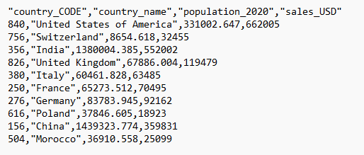
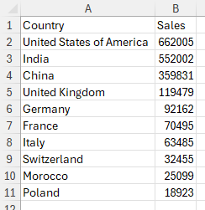

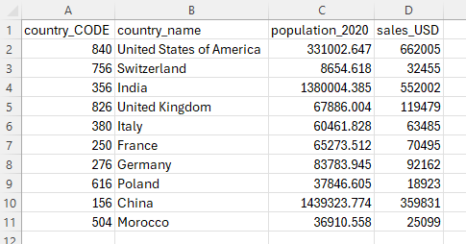
Hello World – An Overview of the ETL Process
Comma Separated File: raw_sales_country.csv
Excel File: Sales By Country.xlsx
KNIME Workflow
1. Extract Data from raw_sales_country.csv
2. Transform Data by aggregating by Country, then sorting by sales, largest first.
3. Load Data to Sales By Country.xlsx

Slide 4
M2: Practice Lab #1 (Hello World) Assignment in KNIME
This lab has 20 steps and is listed from pg. 31-43 in your textbook.
The illustrations and instructions in your text are from v4.7 of KNIME. As of early 2024, v5.1 of KNIME has been released. This presentation is a walkthrough using the v5.1 version of KNIME that is generally available for download, and currently installed on your virtual machines.
The text from your textbook will use the font you’re reading right now, in black color.
Changes from the textbook will use the courier new font in blue color.
We will start on the next slide with Step #1 on pg. 31 of your text.

Slide 5
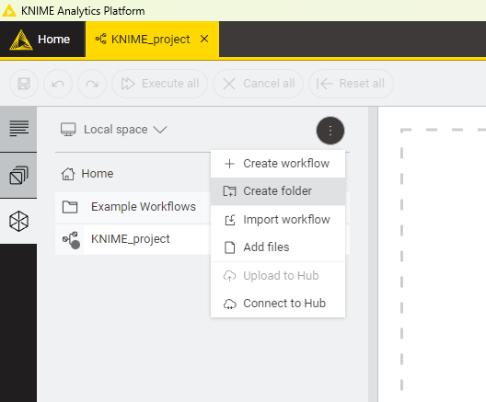
M2: Practice Lab #1 (Hello World) Assignment in KNIME
To keep our workflows tidy, we can organize them hierarchically, in folders: in KNIME, folders are called Workflow Groups. So, let's start by creating a workflow group that will host our first piece of work:
Right-click on the LOCAL entry in the KNIME Explorer section (top-left) and then click on New Workflow Group... in the pop-up menu.
Enter the name of your new folder (you can call it Chapter 2) and click on Finish.
In KNIME v5, you’ll need to click on the “ferris wheel” icon on the left side, which is the third one down. This shows your explorer area. Then, the three dots at the top right of this pane produces a drop down menu where you can select “Create Folder”. Then, a new folder appears in the list where you can change the default name from “Folder” to “Chapter 2”
You may need to right-click on the new folder and select “Rename” from the menu to rename the folder.

Slide 6
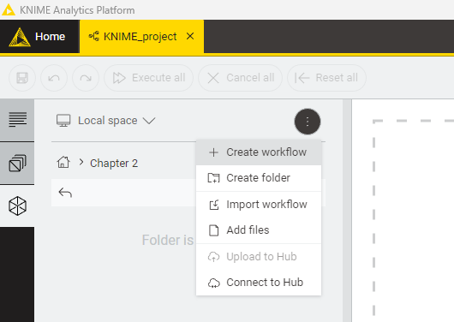
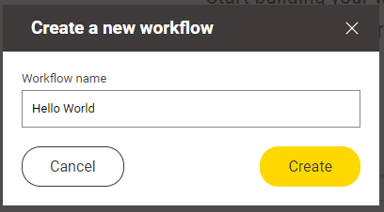
M2: Practice Lab #1 (Hello World) Assignment in KNIME
You will see that the new folder has appeared in your local workspace. Now we can finally create a new workflow within this group. Similar to what you just did when creating a group, you just need to follow a few more steps:
3. Right-click on the newly created workflow group and then on New KNIME Workflow....
4. Enter the name of your new workflow (how about Hello World?) and then click Finish. Your workflow will appear in the editor, which at this point will look like a sheet of squared paper.
Instead, double click on the “Chapter 2” folder, then click the three dots to the right again to make the menu appear. You’ll select “Create workflow” from this menu.
The Create a New Workflow pop-up appears.
Type the name “Hello World” and click the “Create” button.

Slide 7
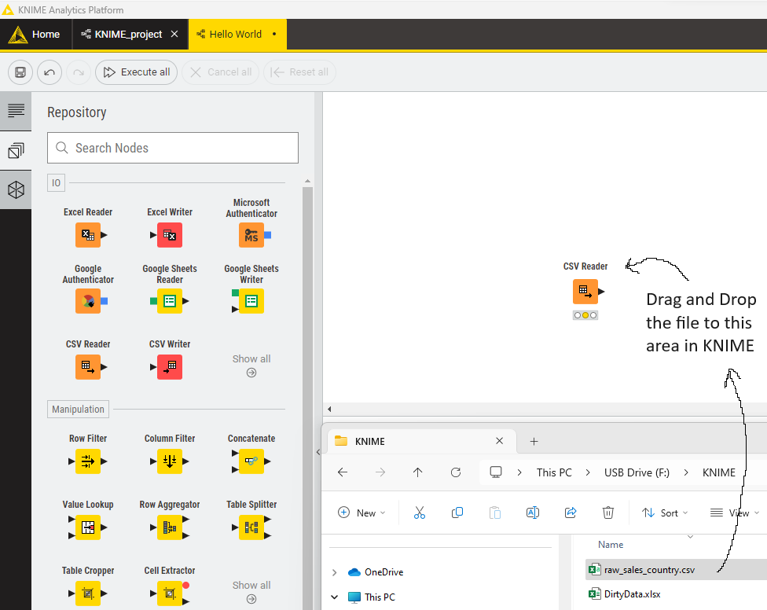
M2: Practice Lab #1 (Hello World) Assignment in KNIME
5. It's time to load our CSV file into KNIME, using the proper input node. The fastest way to do so is to drag and drop the file directly into the Workflow Editor: just grab the file named raw_sales_country.csv from the folder where it is located and drop it anywhere on the blank editor. KNIME will recognize the type of file and automatically implement the right node for reading it: in this case, CSV Reader. As you drop the file, its configuration dialog will appear. If at any point you need to revise its configuration, you can just double-click on the node to obtain the same dialog.
Next, download the raw_sales_country.csv from Canvas to your VM. Once it is loaded to your VM, drag and drop the file from whatever folder you saved it to from Windows Explorer to the area in KNIME that says, “Start building your workflow by dropping your data or nodes here.”

Slide 8
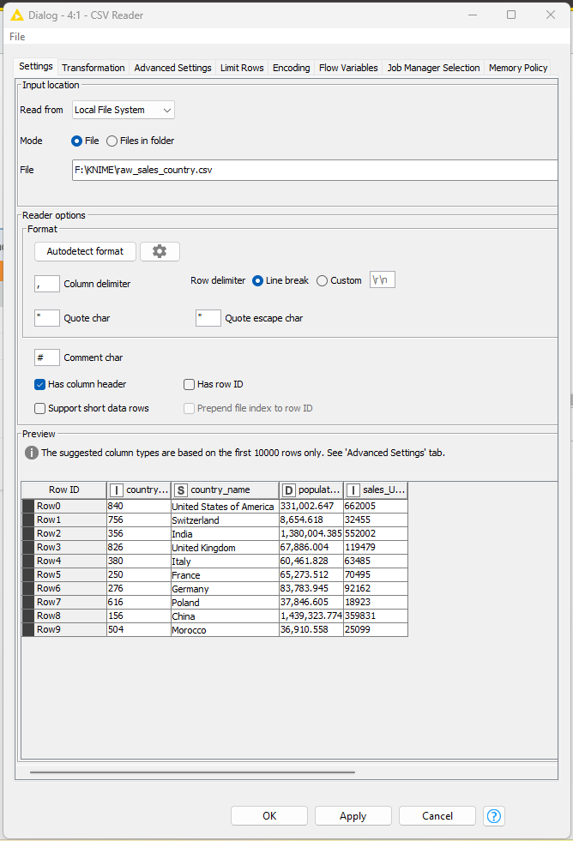
M2: Practice Lab #1 (Hello World) Assignment in KNIME
Like we will do every time we meet a new KNIME node on our journey, let's quickly discover how it works and how to configure it. CSV Reader
This node (available in the repository under the path IO > Reader) reads data from a text file stored in a CSV format and makes it available as a table in KNIME. This node is pretty handy: it attempts to detect the format of the file and recognizes the type of data stored in each column, allowing you to manually change it if needed. It also lets you run some basic reformatting on the fly, like changing the names of columns. As you see in Figure 2.6, its configuration window displays multiple tabs, whose headers appear at the top. The first tab (Settings) lets you set the fundamentals:
• In the first section at the top, you can specify the path of the file to be read: to do so, just click on the Browse... button and select the file. If you dragged and dropped your file in the Workflow Editor, this field is pre-populated. The node lets you also read multiple files in a folder having the same format, by selecting the Files in folder mode.
To see the configuration window, right-click on the CSV Reader node and select Configure. You can also double-click the node to get the configuration window.

Slide 9
M2: Practice Lab #1 (Hello World) Assignment in KNIME
• In the middle section, you can specify the format of the file, like the characters used to delimit rows and columns and if it has column headers. All these parameters get automatically guessed by the node when a new file is loaded (you can click on Autodetect format to force a new attempt). One useful option is Support short data rows: if this box is ticked, the node will keep working even if some rows have incomplete data points. The good news is that in most cases you will not need to change any of these parameters manually as the automatic detection feature is pretty robust.
• At the bottom of the tab, you find the Preview of the table read in the file. This lets you check that the format has been determined correctly.
You’ll find that once you get the configuration window, the look-and-feel between KNIME v4.7 and KNIME v5.1 is about the same.

Slide 10
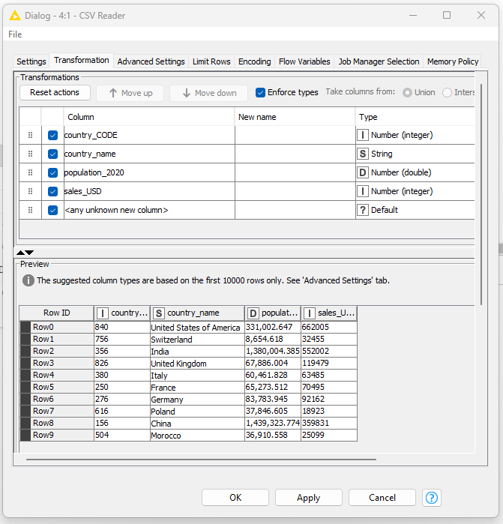
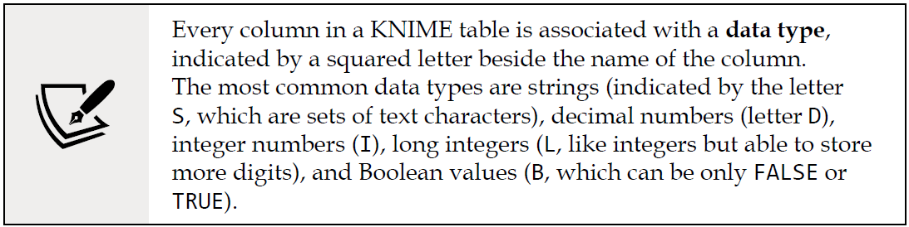
M2: Practice Lab #1 (Hello World) Assignment in KNIME
If you move to the second tab of the window (called Transformation) you will have the opportunity to apply some simple reformatting to your table as it gets loaded. For instance, you can: change the name of columns (just write the new one in the New name column), drop some columns you don't need (untick the box on the left of their name), change the column order (drag and drop them using your mouse), and change their data type (for instance, from text to numbers).
You can check the results of your transformation in the preview section at the bottom. To be clear, you could do these transformations later in your workflow (you have specific KNIME nodes for renaming columns, changing their orders, and so on) but it might be just faster and easier to make these changes here on the spot, using one single node.

Slide 11
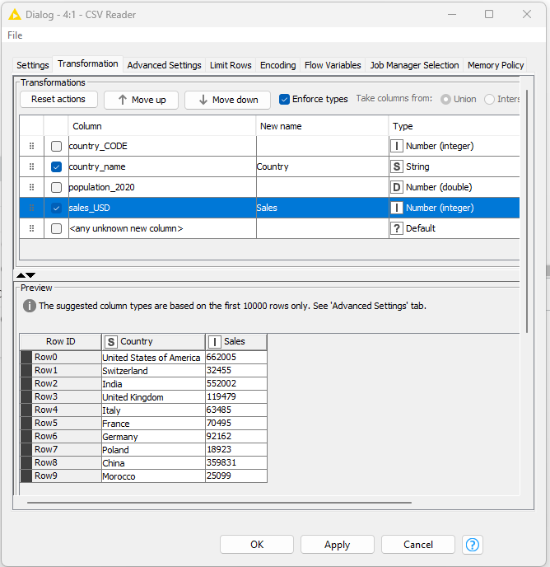
M2: Practice Lab #1 (Hello World) Assignment in KNIME
6. Looking at the preview of the table in the Settings tab, it looks like the node has done a good job of interpreting the format of the file. We just noticed that there are some columns we don't need to carry and they can be dropped (specifically, country_CODE and population_2020) and, also, that we can simplify some of the column names by renaming them. To do this, we need to move to the Transformation tab: just click on its name at the top of the window.
7. Let's first remove the columns we don't need, by just unticking the boxes beside their names, as shown to the right.
8. Let's also assign more friendly titles to the other two columns by typing them in the New name section: let's rename country_name to Country and sales_USD to Sales.
9. The preview of the transformed table looks exactly like we wanted; this means we are done with the configuration of this node, and we can close it by clicking on the OK button.
No changes between KNIME v4.7 and v5.1 to mention in this slide.

Slide 12
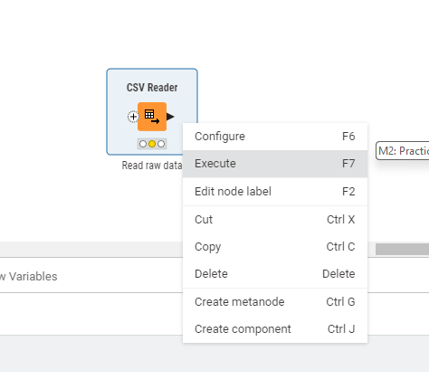
M2: Practice Lab #1 (Hello World) Assignment in KNIME
10. To keep things clear to ourselves and others we want to comment on every node in our workflows. Let's start from this very first node. If we doubleclick on the label underneath (which by default will read Node 1), we can change it to something more meaningful, like Read raw data. From this point on, I will not mention every time we need to comment on each node—just make it become a habit.
11. Our node is displaying an encouraging yellow traffic light: it means it has all it needs to fulfill its duty—we just need to say the word. To execute a node in KNIME, we can either select it and press F7 on our keyboard or right-click on the node to obtain the pop-up menu. When it appears, click on Execute.
No changes between KNIME v4.7 and v5.1 to mention in this slide.

Slide 13
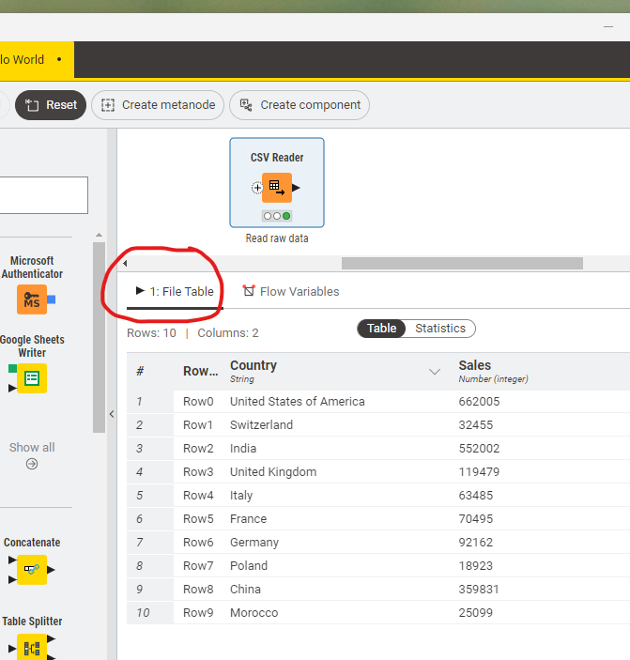
M2: Practice Lab #1 (Hello World) Assignment in KNIME
12. The traffic light turning green is a good sign: our node was successfully executed. A useful feature of KNIME is that you can easily inspect what's going on at each step of the flow, by viewing what data is available at the output ports of every node. In the pop-up menu obtained by right-clicking on a node, you will find one or more icons showing a magnifying lens (normally one for each output port, at the bottom of the menu). By clicking on these icons, you will open a window showing the data you are after. Let’s do so now: right-click to make the pop-up menu appear and then click on File Table at the bottom of the menu (alternatively you can check out the Node Monitor or use the keyboard shortcut to open the first output view of a node, which is Shift + F6). Not surprisingly, we obtain the same table we had in preview in the preview step. It seems that, so far, everything is working right. We can click OK and move on.
If you simply left-click on the CSV Reader node, you’ll observe the “File Table” that shows the output data from this node.

Slide 14
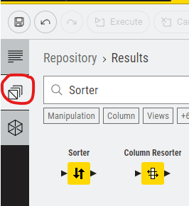
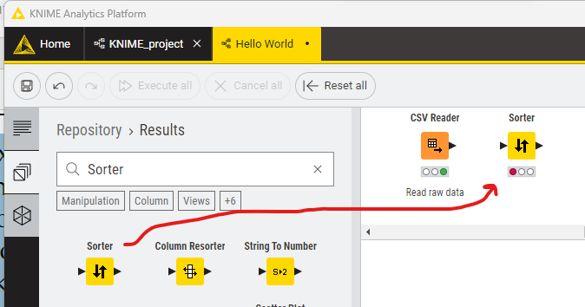
M2: Practice Lab #1 (Hello World) Assignment in KNIME
13. The next step is to sort rows by decreasing amounts of sales. We can use a node that is meant to do exactly that: Sorter. Let's add our Sorter node to the workflow, pulling it from the Node Repository at the bottom left. You can either look it up by typing Sorter in the search box or find it in the hierarchy by clicking first on Manipulation, then Row, and—finally—Transform. When you see the Sorter node, grab it with your mouse and drop it on the workflow, at the right of the CSV Reader node.
The suggested way to find the sorter node is to type “Sorter” in the repository search box as shown.
Remember to access the node repository, you have to click the second icon on the left side. That icon is circled in red.
Drag the yellow sorter node icon shown to the Workflow editor pane somewhere slightly to the right of the CSV Reader node you created in a prior step.

Slide 15
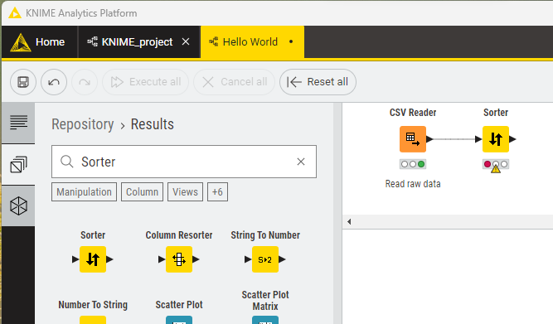
M2: Practice Lab #1 (Hello World) Assignment in KNIME
14. Your node is now lying alone in the workflow while we want it to be cooperating with other nodes. In fact, we need it to sort the table output by the CSV Reader, so we need to create a connection between the two nodes. In KNIME, we create connections by just drawing them with the mouse. Click on the output port of the CSV Reader (the little arrow on its right) and while keeping the mouse button pressed, go to the input port of the Sorter node. When you release the button, you will see a connection appearing between the nodes. This is exactly what we wanted; The table given in the output by the CSV Reader has now become an input for the Sorter.
Click the black triangle to the right of the CSV Reader node, hold the mouse button down and “connect” the node to the left black triangle on the Sorter node.
This tells the workflow to direct the output data from the CSV Reader to the input of the sorter node.
Now you’ll notice the nodes are connected by a black line.

Slide 16
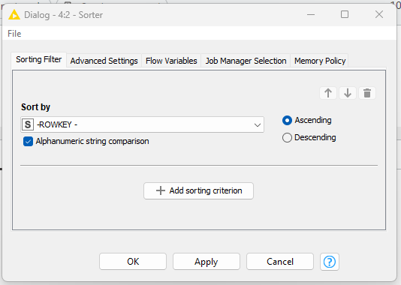
M2: Practice Lab #1 (Hello World) Assignment in KNIME
We are now ready to configure the Sorter: let's learn about our new node.
Sorter
This node (available in the repository in Manipulation > Row > Transform) can sort the rows of a table according to a set of criteria defined by the user. Its configuration is self-explanatory: from the drop-down menu, you can select the column you wish to sort by. The radio buttons on the right let you choose whether the sorting shall follow an Ascending (A to Z or 1 to 9) or Descending (the other way around) order. You can add additional rules on other columns that will come to play to break the ties in case multiple rows carry the same value in a column. To do so, just click on the Add Rule button and you will see further drop-down menus appearing. You can change the order of precedence among multiple rules by using the ↑ and ↓ arrows.
Differences between KNIME 4 and KNIME 5 are: There’s a new “Job Manager Selection” tab, which we don’t use in this lab or class. The button entitled “Add sorting criterion” used to be titled “Add Rule”. No other differences.

Slide 17
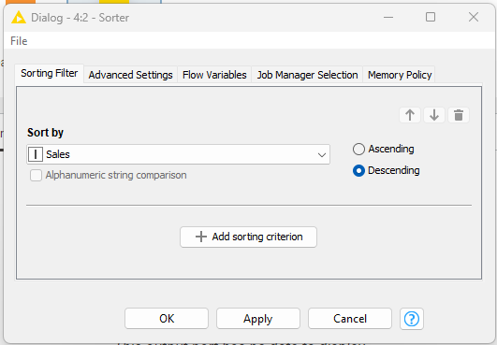
M2: Practice Lab #1 (Hello World) Assignment in KNIME
15. To open the configuration window of Sorter, you can either double-click on the node or right-click on it and then press Configure…. You could also just press F6 on your keyboard after selecting the node with your mouse.
16. Given our needs, the configuration of the node is straightforward: just select Sales in the drop-down menu and then click on the second radio button to apply a descending order. Press OK to close the window.
17. The Sorter node is now clear about the input table to use and about the way we want the sorting to happen: it is all ready to go. Let's execute it (F7 or right-click and select Execute) and open the view showing its output (Shift + F6 or right-click and select Sorted Table, the last icon with the magnifying lens):
The sorter node configuration after steps 15 and 16.
Differences between KNIME 4 and KNIME 5 are: There’s a new “Job Manager Selection” tab, which we don’t use in this lab or class. The button entitled “Add sorting criterion” used to be titled “Add Rule”. No other differences.

Slide 18
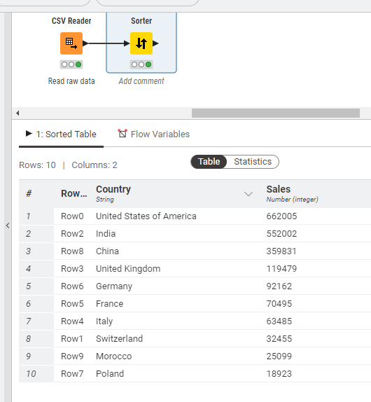
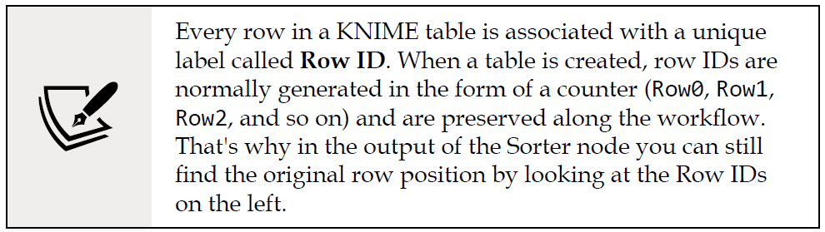
M2: Practice Lab #1 (Hello World) Assignment in KNIME
17. The Sorter node is now clear about the input table to use and about the way we want the sorting to happen: it is all ready to go. Let's execute it (F7 or right-click and select Execute) and open the view showing its output (Shift + F6 or right-click and select Sorted Table, the last icon with the magnifying lens).
Click the sorter node and either press F7 or right-click and select Execute to execute the node.
The sorted output should display at the bottom under the sorted table tab as shown in the figure here.
The sorter node configuration after step 17.

Slide 19
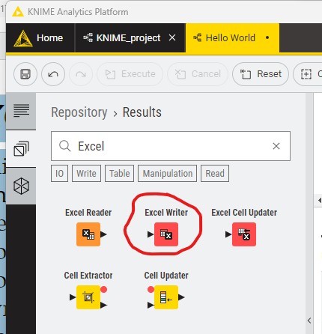
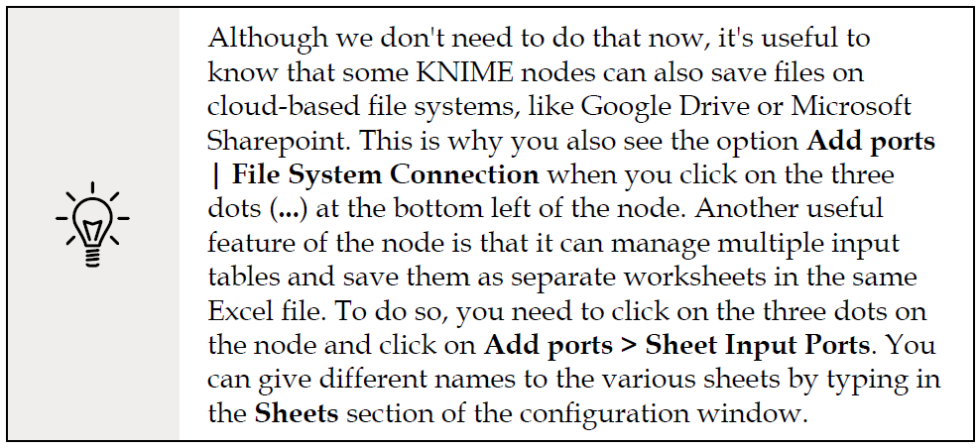
M2: Practice Lab #1 (Hello World) Assignment in KNIME
It looks like we have our countries sorted in the right order and we can proceed to the last step: exporting our table as an Excel file.
Excel Writer
This node (available within IO > Write in the repository) saves data as Excel worksheets. The configuration dialog will let you first select the format of the file to create (the legacy .xls or the latest .xlsx one) and where to save it (click on the Browse... button to select a path). By selecting the if exists radio buttons, you can specify what to do if a file with that name is already there where you want to save it: you can overwrite the old data, append the new data as additional rows, or preserve the original file. An important option to check is Write column headers: when selected, the column names of your table are added as headers in the first row of your Excel file.
To find the node in KNIME v5, follow roughly the same process as you did with the sorter node. Type Excel in the sort box. When it’s time, be sure to select the Excel Writer and not accidentally select the Excel Reader node!

Slide 20
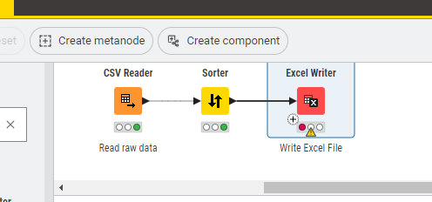
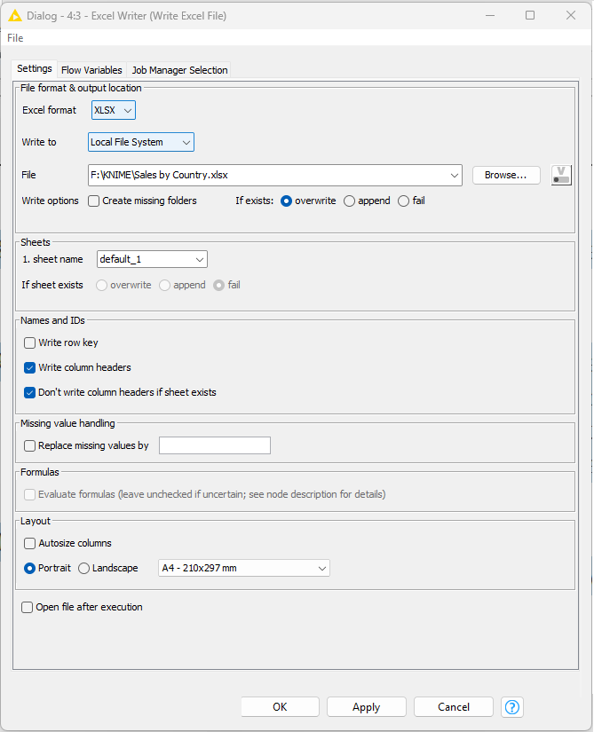
M2: Practice Lab #1 (Hello World) Assignment in KNIME
18. Let's add the Excel Writer node to our workflow, dragging it from the Node Repository, and then create a connection between the output port of the Sorter and the input node of the Excel Writer.
19. Open the configuration window of the Excel Writer (double-click on it). The only configurations we need to add in this case are the location and the name of the output file (click on the Browse... button, go to the desired folder, and type the name of the new file) and, since we might need to repeat this process regularly, select the overwrite option using the radio button below.
The browse button in #19 is next to the File field, but it’s WAY over to the right. If the configuration window/your screen is too small, you may not see it.
Notice the filename: “Sales by Country.xlsx” (Your drive letter and folder will be different)
Notice the If exists: overwrite button selected.
The Excel Writer node configuration after steps 18 and 19.

Slide 21
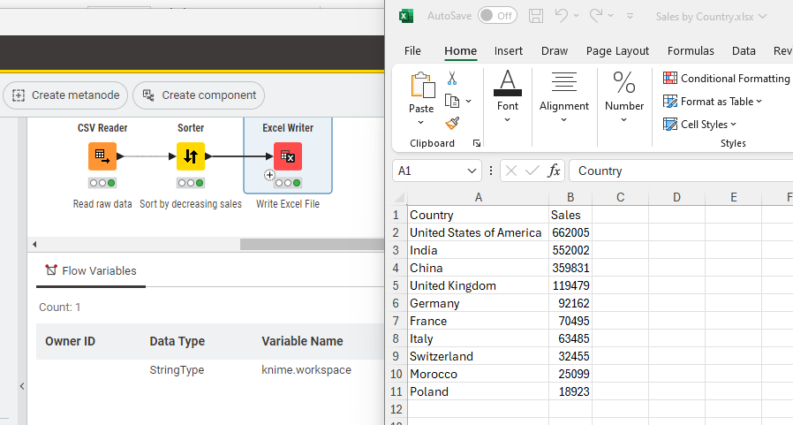
M2: Practice Lab #1 (Hello World) Assignment in KNIME
20. It's time to run the node (F7 or right-click and select Execute) and open the new file in Excel. You'll be pleased to see that the new file looks exactly how we wanted.
The Excel file is located right where you told it to be saved in the file configuration of the Excel Writer node. Look there. Double-click on the file and it will load in Excel.
I added a comment under the Sorter node while you weren’t looking ☺

Slide 22
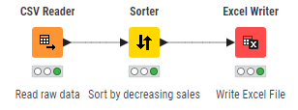
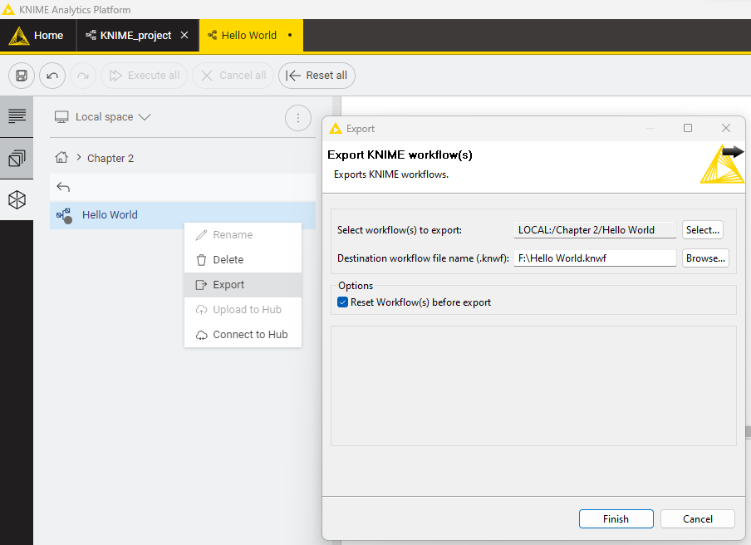
M2: Practice Lab #1 (Hello World) Assignment in KNIME
Congratulations on creating your first KNIME workflow! By combining three nodes and configuring them appropriately, you implemented a simple data transformation routine that you can now repeat in a matter of seconds, whenever it's needed. More importantly, we used this first tutorial to get acquainted with the fundamental operations you need to build any workflow, such as pulling the right nodes, configuring and executing them, and checking that all works as it should.
We now have all we need to start building more complex data operations, discovering what other KNIME nodes can do, and this is exactly what we will do in the next few pages. Since we don't want to lose our precious Hello World workflow, it would be a good idea to save it: just press Ctrl + S on your keyboard or click on the disk icon at the top left of your screen. If you want to share your workflow with others, you first need to export it as a standalone file. To do so, right-click on the name of the workflow within the KNIME Explorer panel on the left and then select Export KNIME Workflow...:
To export, select the ferris wheel, and right-click on your Hello World workflow and select Export from the menu as shown.

Slide 23
M2: Practice Lab #1 (Hello World) Assignment in KNIME
In the window that appears, you will have to specify the location and name of the file with your workflow by clicking on the Browse... button. If you keep the Reset Workflow(s) before export option checked, KNIME will only export the definition of the workflow (the nodes' structure and their configuration) without any data in it. If you untick it, the data stored in every executed node will be exported as well (making your export much larger in size). You can now send the resulting file (with .KNWF as an extension) via email or save it in a safe place. Whoever receives it can import it back in their KNIME installation by clicking on File | Import KNIME Workflow... and selecting the location of the file to import and the destination of the workflow.
Be sure to take note of the Destination workflow file name (.knwf) that you select. This tells KNIME which folder to save your workflow file. You’ll need to go there and get it later to upload to Canvas!
Speaking of Canvas, you’ll need to upload both your .knwf file and the final “Sales by Country.xlsx” file that your workflow created. Create a ZIP file with both of these files and upload the ZIP file to Canvas.

